Slide 1
Topic 4 – Arrays and Array Algorithms

Slide 2
Java program structure
Java programs are built up of multiple files called classes
There are advantages in splitting a program into distinct files rather than keeping it in one big chunk
The different components can be easily re-used
The same piece of code can be re-run as many times as you want without re-typing it
Classes are made up of variables and methods
Variables store information
Methods are contained chunks of code which do a specific job and then return a result

Slide 3
Arrays
Say that you are writing a program that reads in 100 numbers for data.
Would you like to declare 100 variables and write 100 input statements to read in the data?
Even if it was 6 numbers, it’s not too efficient to declare 6 separate variables, provided they are of the same type.
The solution to grouping large numbers of variables together is to use arrays

Slide 4
Arrays
An array is an object that is used to store a list of values
It is made out of a contiguous block of memory that is divided into a number of "slots“
Each slot holds a value, and all the values are of the same type.
In the example array here, each slot holds an int
index | data
0 | 23
1 | 15
2 | 99
3 | 37
4 | 2
5 | 14

Slide 5
Arrays
In the example array here, each slot holds an int
Arrays have names, for example this one is called data
The slots are indexed 0 through 5.
Each slot can be accessed by using its index.
For example, data[0] is the slot which is indexed by zero (which contains the value 23).
data[5] is the slot which is indexed by 5 (which contains the value 14)
index | data
0 | 23
1 | 15
2 | 99
3 | 37
4 | 2
5 | 14

Slide 6
Arrays
Important:
The slots are numbered sequentially starting at zero.
If there are N slots in an array, the indexes will be 0 through N-1
If you write a for loop cycling through all of the slots in an array, make sure it stops at N-1
Example.
public static void printArray (String arr) {
for(int i = 0; i < arr.length; i++) {
System.out.println(arr[i]);
}
}
// arr.length is the length of array arr

Slide 7
Arrays
For example, the array data is as follows
Then data.length is 6.
The slots of data are indexed 0 through 5.
index | data
0 | 23
1 | 15
2 | 99
3 | 37
4 | 2
5 | 14

Slide 8
Using Arrays
Every slot of an array holds a value of the same type.
For example, you can have an array of int, an array of double, and so on.
This array holds data of type int.
Every slot may contain only an int.
A slot of this array can be used anywhere a variable of type int can be used.
Example.
data[3] = 55;
index | data
0 | 23
1 | 15
2 | 99
3 | 55
4 | 2
5 | 14

Slide 9
Using Arrays
Any of the array entries (or elements) can be used exactly the same way as a standard variable, including arithmetic expressions.
For example, if x contains a 11, then
(x + data[2]) / 5
evaluates to (11+99) / 5 = 22
index | data
0 | 23
1 | 15
2 | 99
3 | 55
4 | 2
5 | 14

Slide 10
Using Arrays
Here are some other legal statements:
data[0] = (x + data[2]) / 4 ;
data[2] = data[2] + 1;
x = data[3]++ ; // data in slot 3 is incremented
data[1] = data[5] / data[4];

Slide 11
Declaring Arrays
Array declarations look like this:
type[] arrayName = new type[ length ];
This names the type of data in each slot and the number of slots.
Once an array has been constructed, the number of slots it has does not change.
Example.
Construct a int array of length 3.
int[] arr1= new int[3];

Slide 12
Declaring Arrays
Examples.
int[] myArray = new int[20];
double[] theArray = new double[5];
String[] words = new String[17];
char[] charArray = new char[256];
Example.
int[] arr2 = {10, 20, 30};
// Here, we set data into this array directly
// That is arr2[0] = 10, arr2[1] = 20, and arr2[2] = 30

Slide 13
Array Boundary Checking
The length of an array is how many slots it has.
An array of length N has slots indexed 0 … (N-1)
Indexes must be an integer type.
It is OK to have spaces around the index of an array
For example data[1] and data[ 1 ] are exactly the same as far as the compiler is concerned
It is not legal to refer to a slot that does not exist

Slide 14
Array Boundary Checking
Say that an array was declared:
int[] data = new int[10];
Here are some elements of this array, are they valid?
data[ -1 ]
data[ 0 ]
data[ 1.5 ]
data[ 9 ]
data[ 10 ]

Slide 15
Array Boundary Checking
Say that an array was declared:
int[] data = new int[10];
Here are some elements of this array, are they valid?
data[ -1 ] | always illegal, the index of array must be positive integer
data[ 0 ] | always OK
data[ 1.5 ] | always illegal
data[ 9 ] | always OK
data[ 10 ] | illegal, the index of array is must less then its length

Slide 16
Array Boundary Checking
Error line 17: ArrayIndexOutOfBoundsExceptionError
This means you’ve overstepped the boundaries of the array
You have used either an index less than 0, or greater than N-1, where N is the length of the array
This problem is only revealed when you run the program, not when you compile
Example.
public static void main(String[] args) {
int arr[] = {13, 42};
System.out.println(arr[2]); // the length of arr[] is 2
}

Slide 17
Variables as Index Values
The index of an array is always an integer type
This means it can be any expression that evaluates to an integer.
For example, the following are legal:
int[] values = new int[7];
int index = 0;
values[ index ] = 71; // put 71 into slot 0, that is values[0] = 71
index = 5;
values[ index ] = 23; // put 23 into slot 5, that is values[5] = 23
index = 3;
values[ 2+2 ] = values[ index-3 ]; //same as values[4] = values[0];

Slide 18
Variables as Index Values
Using an expression for an array index is a very powerful tool
Often a problem is solved by organizing the data into arrays, and then processing that data in a systematic way using variables as indexes

Slide 19
Variables as Index Values
Using an expression for an array index is a very powerful tool
Here are further examples:
double[] val = new double[4];
val[0] = 0.12;
val[1] = 1.43;
val[2] = 2.98;
int j = 2;
System.out.println("slot 2:" + val[j] ); // val[j] = val[2]
System.out.println("slot 1:" + val[j-1] ); //val[j-1]=val[1]
j = j-2;
System.out.println("slot 0:" + val[j] ); //val[j] = val[0]

Slide 20
Initial Values
When array is created, all values are initialized depending on array type:
Numbers: 0
Boolean: false
Object References: null
Example.
int[] val = new int[3];
We have
val[ 0 ] = 0
val[ 1 ] = 0
val[ 2 ] = 0

Slide 21
Array initialization as a list
You can declare, construct, and initializes the array all in one statement:
int[] data = {23, 38, 14, -3, 0, 14, 9, 103, 0, -56};
This declares an array of int which is named data. Then it constructs an int array of 10 slots (indexed 0…9)
Finally it puts the designated values into the slots.
The first value in the list corresponds to index 0, the second value corresponds to index 1, and so on
So in this example, data[0] gets the 23

Slide 22
Copying Arrays
Say we have two arrays:
int[] array1 = {17,12,32,103,5};
int[] array2 = {22,57,13,203,15};
How do we copy the contents of array1 into array2?
Can we just do this?
array2 = array1;

Slide 23
Copying Arrays
array2 = array1;
We just get two references to the same array
array1
index | value
0 | 23
1 | 15
2 | 99
3 | 55
4 | 2
5 | 14
array2

Slide 24
Copying Arrays
This does not work!
array2 = array1;
Never do this!
Worst of all, it does not cause an error, so remember it!!!
Arrays must be dealt with on an element by element basis

Slide 25
Copying Arrays
If you do
array2 = array1;
The problem is if you change the value of some slot of array1, then same slots of array2 is change too.
In other words, you set an array two names, one is array1, and the other one is array2
In fact, it doesn't make much sense
It will only make your code error prone when it is executed

Slide 26
Copying Arrays
You must copy all the elements one by one
How about…
array2[0] = array1[0];
array2[1] = array1[1];
array2[2] = array1[2];
array2[3] = array1[3];
array2[4] = array1[4];
This will work, but it’s a little inefficient, isn’t it?
We can produce the same effect using a loop

Slide 27
Copying Arrays
Arrays must be of the same type...
double[] array1 = {9, 8, 7, 6, 5, 4, 3, 2, 1, 0};
double[] array2 = new double[10];
for(int i = 0; i < array1.length; i++){
array2[i] = array1[i];
}
array2[ 0] = array1[ 0];
array2[ 1] = array1[ 1];
array2[ 2] = array1[ 2];
array2[ 3] = array1[ 3];
…
array2[10] = array1[10];
// use loop to copy the contents of array1 into array2?

Slide 28
Printing Arrays
To print any array, it’s just the same…
for(int j = 0; j < array.length; j++) {
System.out.println(array[j]);
}
// use loop to print each element of an array

Slide 29
Arrays and Loops
THINK OF FOR LOOPS!
Why?
Because for loops execute for an exact number of times, no more, no less
This is tailor made for arrays which are always of a definite size

Slide 30
Array Length
If we are uncertain about the size of an array, we can use array.length to get it
Because arrays are a fundamental data type, we get the length using the statement
int length = array.length;
Because Strings are a class, when we get the length of a String we are calling a method and must provide brackets
int length = message.length();

Slide 31
Exercise
Write a program that:
takes the array size as input from the user,
creates an int array of that size,
populates it with values, prompting the reader for each value.

Slide 32
Program of Exercise
import java.util.Scanner;
public class loop {
public static void main(String[] args) {
Scanner kbinput = new Scanner(System.in);
System.out.println("Please enter array size");
int size = kbinput.nextInt();
int[] array = new int[size];
for(int i = 0; i < size; i++){
System.out.println("Enter array value" +i);
array[i] = kbinput.nextInt();
}
}
}
// takes the array size as input from the user

Slide 33
Program of Exercise
import java.util.Scanner;
public class loop {
public static void main(String[] args) {
Scanner kbinput = new Scanner(System.in);
System.out.println("Please enter array size");
int size = kbinput.nextInt();
int[] array = new int[size];
for(int i = 0; i < size; i++){
System.out.println("Enter array value" +i);
array[i] = kbinput.nextInt();
}
}
}
// creates an int array of that size

Slide 34
Program of Exercise
import java.util.Scanner;
public class loop {
public static void main(String[] args) {
Scanner kbinput = new Scanner(System.in);
System.out.println("Please enter array size");
int size = kbinput.nextInt();
int[] array = new int[size];
for(int i = 0; i < size; i++){
System.out.println("Enter array value" +i);
array[i] = kbinput.nextInt();
}
}
}
// populates it with values, prompting the reader for each value

Slide 35
Nested Loops
This code uses nested for loops to print out each name in each slot, one character at a time
The outer loop selects a name in a particular slot
The inner loop prints out each character of that name, one at a time
String[] names = {"Peter", "Susan", “Keith"...};
for(int i = 0; i < names.length; i++){
for(int j = 0; j < names[i].length(); j++){
System.out.print(names[i].charAt(j) + " ");
}
System.out.println();
}

Slide 36
2D Arrays
Often data comes naturally in a two dimensional form.
For example, maps are two dimensional, the layout of a printed page is two dimensional, a computer-generated image (such as on your computer screen) is two dimensional, and so on.
Think Battleships, or chess in a newspaper, or reading a map.
It’s always just rows by columns, x by y, whatever way you want to think of it…
So, instead of one value to specify an array element or slot, we now need two

Slide 37
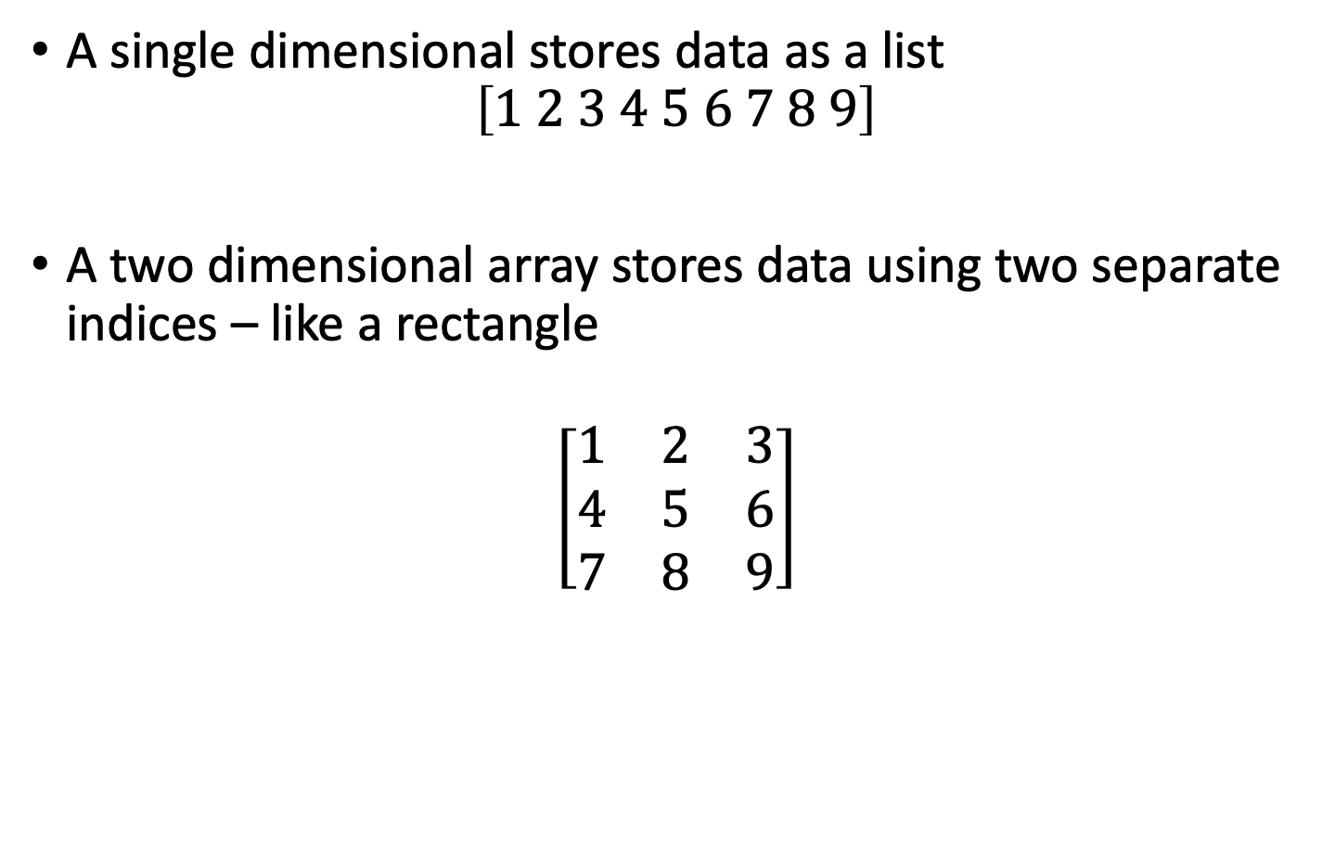
Two Dimensional Arrays
A single dimensional stores data as a list
$$\left[1 2 3 4 5 6 7 8 9\right]$$
A two dimensional array stores data using two separate indices – like a rectangle
$$\left[\begin{matrix}1 & 2 & 3 \\ 4 & 5 & 6 \\ 7 & 8 & 9\end{matrix}\right]$$

Slide 38
2D Arrays
int[][] gradeTable= new int[7][5]
gradeTable[0][1] //holds 42
gradeTable[3][4] //holds 93
gradeTable[6][2] //holds 78
Student | Week
 | 0 | 1 | 2 | 3 | 4
0 | 99 | 42 | 74 | 83 | 100
1 | 90 | 91 | 73 | 88 | 95
2 | 88 | 61 | 74 | 89 | 96
3 | 61 | 89 | 82 | 98 | 94
4 | 93 | 73 | 75 | 78 | 99
5 | 50 | 65 | 92 | 87 | 94
6 | 43 | 98 | 78 | 56 | 99

Slide 39
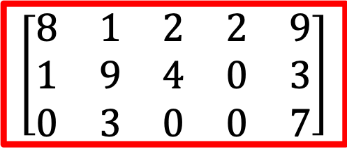
2D Arrays
int[][] myArray = new int[3][5];
Will result in an array the same size as if we declared it as
int[][] myArray = {{8,1,2,2,9},{1,9,4,0,3}, {0,3,0,0,7}};
myArray[2][4] holds the value 7
myArray[1][0] holds the value 1
Remember, row first, then column
$$\left[\begin{matrix}\begin{matrix}8 & 1 & 2 \\ 1 & 9 & 4 \\ 0 & 3 & 0\end{matrix} & \begin{matrix}2 & 9 \\ 0 & 3 \\ 0 & 7\end{matrix}\end{matrix}\right]$$

Slide 40
Initializing 2D Arrays
Usually, the number of rows and columns will be stored in variables
Sometimes you will want to fill an array with default values
Sometimes you will want to search through the whole array for a particular value
It is common to use two nested loops when filling or searching a two-dimensional array:
for (int i = 0; i < rows; i++) {
for (int j = 0; j < columns; j++) {
board[i][j] = " ";
}
}

Slide 41
Initializing 2D Arrays
Lets say rows = 3 and columns = 3. Then this happens:
board[0][0] = “ ”;
board[0][1] = “ ”;
board[0][2] = “ ”;
board[1][0] = “ ”;
board[1][1] = “ ”;
board[1][2] = “ ”;
board[2][0] = “ ”;
board[2][1] = “ ”;
board[2][2] = “ ”;
for (int i = 0; i < rows; i++) {
for (int j = 0; j < columns; j++) {
board[i][j] = " ";
}
}

Slide 42
Random Numbers
Math.random() provides a random number that great than and equal to 0 and small than 1
Math.random(): 0 ➔ 1
System.out.println("Here's one random number: " + Math.random());
System.out.println("Here's another random number: " + Math.random());
The random number that is generated is of type double.
If you need an int, you have to cast it by putting (int) in front

Slide 43
Random Numbers
how about a random number in the range of 0 to 99.99…?
double number = Math.random()*100;
how about an random int in the range of 0 to 99?
int number = (int)(Math.random()*100);
how about an random int in the range of 10 to 99?
int number = (int)((Math.random()*90)+10);

Slide 44
Fill an Array with Random Numbers
int[] randArray = new int [100];
for(int i = 0; i < randArray.length; i++) {
randArray[i] = (int)(Math.random()*100.0);
}
//Loops through 100 times and fills it in!

Slide 45
The Sieve of Eratosthenes
The Sieve of Eratosthenes is a famous method for obtaining prime numbers
Eratosthenes was a famous Greek mathematician (276 BC – 194 BC) born in Libya
A prime integer is any integer that is only divisible by itself and 1
2, 3, 5, 7, 11, 13, 17, 19, 23, ...
There is no simple way to predict which numbers are going to be prime without testing them using an algorithm

Slide 47
The Algorithm
First step: create a boolean array with a size which corresponds to the range of numbers you want to check:
boolean[] sieve = new boolean[12];
Put all of the values equal to true from 2 onwards
for(int i = 2; i < 12; i++){
myArray[i] = true;
}
0 | 1 | 2 | 3 | 4 | 5 | 6 | 7 | 8 | 9 | 10 | 11
false | false | true | true | true | true | true | true | true | true | true | true

Slide 48
The Algorithm
Starting with the element in slot 2, check if the value in that slot is true – if not skip it and go onto the next number
If so, it is a prime number – print it out...
Now loop through the remainder of the array and set to ‘false’ every element whose slot number is a multiple of that slot number
0 | 1 | 2 | 3 | 4 | 5 | 6 | 7 | 8 | 9 | 10 | 11
false | false | true | true | false | true | false | true | false | true | false | true
2 is prime

Slide 49
The Algorithm
0 | 1 | 2 | 3 | 4 | 5 | 6 | 7 | 8 | 9 | 10 | 11
false | false | true | true | false | true | false | true | false | true | false | true
Now loop through the remainder of the array and set to ‘false’ every element whose slot number is a multiple of that slot number
2 is prime
0 | 1 | 2 | 3 | 4 | 5 | 6 | 7 | 8 | 9 | 10 | 11
false | false | true | true | false | true | false | true | false | false | false | true
3 is prime

Slide 50
The Algorithm
For example, for the element in slot 2, all elements beyond 2 in the array that are multiples of 2 will be set to ‘false’ (e.g. slot numbers 4, 6, 8, 10 etc.)
For slot number 3, all elements beyond 3 in the array that are multiples of 3 will be set to ‘false’ (e.g. slot numbers 6, 9, 12, 15 etc.)
When you are finished any slot which still contains ‘true’ must be a prime number
0 | 1 | 2 | 3 | 4 | 5 | 6 | 7 | 8 | 9 | 10 | 11
false | false | true | true | false | true | false | true | false | false | false | true

Slide 51
Program
boolean[] sieve = new boolean[100];
for(int i = 2; i < 100; i++) {
myArray[i] = true;
}
for(int i = 2; i < 100; i++) {
if(myArray[i] == true) {
int temp = i;
for(int j = 2i; j < 100; j = j + i) {
myArray[j] = false;
}
}
}
0 | 1 | 2 | 3 | 4 | 5 | 6 | 7 | 8 | 9 | 10 | 11
false | false | true | true | false | true | false | true | false | true | false | true
2 is prime

Slide 52
Algorithm Structure
Use a nested for loop
The outer loop loops through all the numbers from two onwards checking if they are true or false
The inner loop figures out all of the multiples and sets the contents of those slot numbers to false
The inner loop goes to the end of the array and goes up in jumps of the multiple
for(int i = 2; i < 100; i++) {
if(myArray[i] == true) {
int temp = i;
for(int j = 2i; j < 100; j = j + i) {
myArray[j] = false;
}
}
}

Slide 53
Randomize an Array
Say we want to mix up all the elements in an array
How can we swap all of the elements around in a random order?
e.g. shuffling a deck of cards
Java lets us select a random number in a range
Math.random( ) returns a random floating point number between 0 and 1
We can cast it into an int and then multiply by 5 to give us a number between 0 and 4
int randomnumber = (int)(Math.random()*5);
0 | 1 | 2 | 3 | 4

Slide 54
Random Swaps
A good way to randomize the array is actually to go through each item and swap it with another random item
Advantages:
We don’t need to create another array and waste space
We only need to make one copy of a variable at a time in order to swap it
The final ordering will be completely random
Disadvantages:
Some numbers may be swapped multiple times
0 | 1 | 2 | 3 | 4
4 | 1 | 2 | 3 | 0
4 | 2 | 1 | 3 | 0

Slide 55
Swapping
Lets swap slot 1 with slot 4
Step 1. Backup slot 1 into temp
Step 2. Copy slot 4 into slot 1
Step 3. Copy temp into slot 4
i.e., set temp = arr[1]
0 | 1 | 2 | 3 | 4
temp = 1
0 | 4 | 2 | 3 | 4
temp = 1
0 | 4 | 2 | 3 | 1
temp = 1

Slide 56
Swapping
In order to swap one variable with another in an array
Back-up variable #1 (the one that will be overwritten first) into a temporary variable
Overwrite variable #1 with the value of variable #2
Use the temporary variable to overwrite the value of variable #2 with the original value of variable #1
int temp = array[ i ];
array[ i ] = array[ random ];
array[ random ] = temp;

Slide 57
Monte Carlo method
Often it is complicated to work out precise mathematical formulae which describe how a system works
The lazier solution is simply to model the system and run the simulation many times randomly
You base the probability on what you observe, letting the simulation do the hard work

Slide 58
Monte Carlo method
Even the value for PI can be calculated using a Monte Carlo method
Draw a square on the ground and inscribe a circle in it
Scatter some grains of rice randomly throughout the square (or count rain drops falling into it etc.)
The ratio of grains of rice in the square to grains of rice in the circle will be the ratio of their areas, or PI/4

Slide 59
Array Linear Search
To find an item in an array, start at the beginning and check every item
public int search (int searchKey) {
for(int j = 0; j < array.length; j++) {
if(array[j] == searchKey) {
return j;
}
}
return null;
}
// searchKey is in array[]
// searchKey is NOT in array[]

Slide 60
Counting matches
Count the number of items with a searchKey greater than a specified threshold
public int countMatches (int threshold) {
int count = 0;
for(j = 0; j < array.length; j++) {
if(array[j] > threshold){
count++;
}
}
return count;
}
// greater than a specified threshold

Slide 61
Finding the Maximum or Minimum
Algorithm:
Step1. Initialize a candidate with the starting element
Step2. Compare candidate with remaining elements
Step3. Update it if you find a larger or smaller value

Slide 62
Find Biggest
Find the biggest value in the array
Go through every element and track biggest found so far
public int findMax() {
int biggestSoFar = array[0];
for(int j = 1; j < array.length; j++){
if(array[j] > biggestSoFar){
biggestSoFar = array[j];
}
}
return biggestSoFar;
}

Slide 63
Find Biggest
Find the biggest value in the array
Go through every element and track biggest found so far
public int findMax() {
int biggestSoFar = array[0];
for(int j = 1; j < array.length; j++){
if(array[j] > biggestSoFar){
biggestSoFar = array[j];
}
}
return biggestSoFar;
}
Step1. Initialize a candidate with the starting element
Step2. Compare candidate with remaining elements
Step3. Update it if you find a larger value

Slide 64
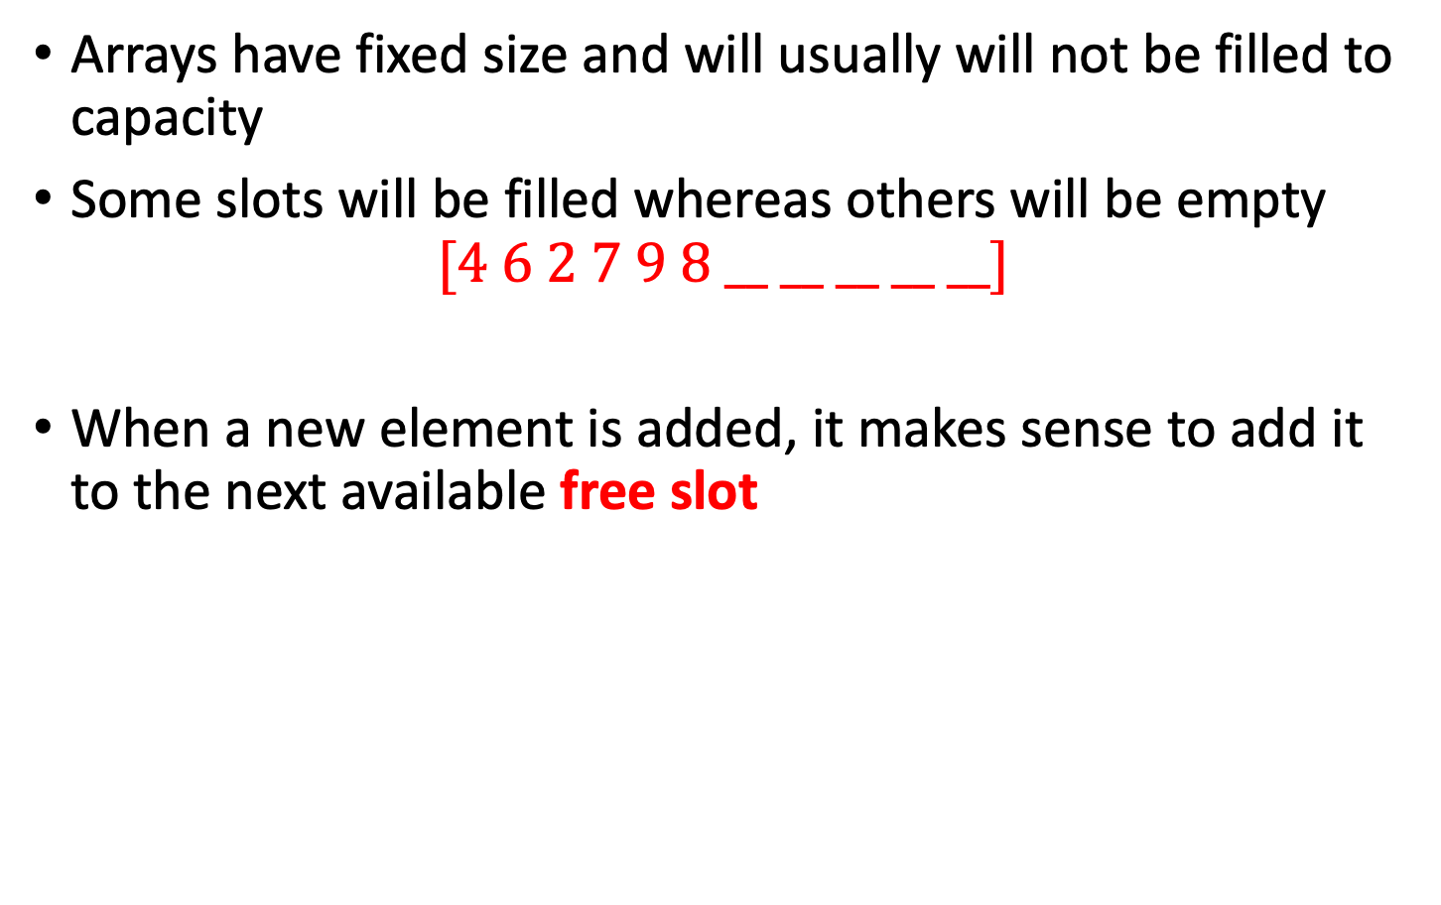
Inserting into an Array
Arrays have fixed size and will usually will not be filled to capacity
Some slots will be filled whereas others will be empty
$$[4 6 2 7 9 8 __ __ __ __ __]$$
When a new element is added, it makes sense to add it to the next available free slot

Slide 65
Inserting into an Array
If we know how many elements are in the array then we know what the next available slot number is
We use a variable to track how many elements are currently in the array
For example, if dataSize = 6 this means there are six elements in the array and the next available slot will be the seventh slot, namely data[6]
final int LENGTH = 100;
double[] data = new double[LENGTH];
int dataSize = 0;
Here, we use dataSize to record which slot is free now

Slide 66
Inserting into an Array
double[]
A Partially Filled Array
Next element inserted goes in slot [dataSize]
Update dataSize as array is filled:
public void insert (int value){
data[dataSize] = value;
dataSize++;
}
dataSize = 6
data.length

Slide 67
Growing an Array
If the array is full and you need more space, you can grow the array:
Step 1. Create a new, larger array
double[] newData = new double[2 * data.length];
Step 2. Copy all elements into the new array
for(int i = 0; i < data.length; i++) {
newData[i] = data[i];
}
Step 3. Change the reference to point to the new array
data = newData;

Slide 68
Growing an Array
Step 1
Step 2
Step 3
data
data
double[]
double[]
double[]
data
newData
newData
newData
Create a new, larger array
double[]
double[]
double[]
Copy all elements into the new array
Change the reference to point to the new array

Slide 69
Problems with Arrays
You need to keep track of what slot in the array is the next free one
You need to write special code to search and delete a particular element
Every time you want to find an item, you have to check EVERY item
Every time you want to delete an item you have to check EVERY item
As the array gets bigger and bigger it will take longer and longer to find what you want
Imagine looking for a word in a dictionary and having to check every word!

Slide 70
Ordered Arrays
When you have to check every item this is known as linear search
We notice that dictionaries and telephone directories are ordered
This makes it easier to find stuff we’re looking for
If information is ordered then you can use a binary search

Slide 71
Ordered Arrays
If an array is in order and we want to search for a particular entry then we just play the guessing game
We try the middle element first (like guessing 50 for a number between 1 and 100)
If the middle element is smaller than the one we’re looking for, we know that the element must be in the second half
If the middle element is bigger then the one we’re searching for must be in the first half

Slide 72
Ordered Arrays
Computer: Guess my number between 1 and 100
You: 50
Computer: Too low!
You: Aha, the number must be between 50 and 100. I guess 75
Computer: Too high!
You: Aha, the number must be between 50 and 75. I guess 63 which is in the middle again.
Computer: Too low!
You: Now I’m getting close. The number must be between 63 and 75. How about 69?
Computer: Too high!
You: 66
Computer: You got the correct answer! There were 100 numbers but you guessed in only 5 guesses

Slide 73
What do we need?
We keep dividing our search space and therefore need to keep track of the limits
Upper bound
Lower bound
Example.
Our search space is between 15 and 49.
Upper bound: 49
Lower bound: 15
Then we try the middle element 27 = (15+49)/2
If the number is bigger than 27 then 27 is the new lower bound
That is the new search space is between 27 and 49.
Upper bound: 49
Lower bound: 27

Slide 74
Binary Search
In the following code we use the following variables:
searchKey is the number we’re looking for
nElems is the number of elements in the array (it might not be full)
lowerBound and upperBound are used to track the range of our search
Here, we set lowerBound and upperBound being the slots which store the value of the lower bounded and the value of the upper bound.
check is used to store the slot number we are currently checking
myArray is the array we’re searching through

Slide 75
Binary Search
searchKey is the number we’re looking for
nElems is the number of elements in the array (it might not be full)
lowerBound and upperBound are used to track the range of our search
check is used to store the slot number we are currently checking
myArray is the array we’re searching through
lowerBound
upperBound
Slot | 9 | 10 | 11 | … | 18 | 19 | 20 | … | 29
Data | 11 | 13 | 15 | … | 43 | 51 | 62 | … | 99
check = (lowerBound + upperBound ) / 2

Slide 76
Code
public int find(int searchKey) {
int lowerBound = 0;
int upperBound = nElems-1;
int check;
while(true) {
check = (lowerBound + upperBound ) / 2;
if(myArray[check] == searchKey) { return check; } // found it
else if(lowerBound > upperBound) { return -1; } //can't find it
else{ // divide range
if(myArray[check] < searchKey) { lowerBound = check+1;}
// it's in upper half
else{ upperBound = check - 1; } // it's in lower half
} // end else divide range
} // end while ————————————————————!!!
} // end find()

Slide 77
Keeping things ordered
In order to be able to run a binary search like this, the array we’re working with has to be sorted
Now we need new algorithms to keep our array sorted
Whenever a new number is inserted, it has to be inserted into the correct place
Whenever a number is removed, the gap it leaves behind has to be filled

Slide 78
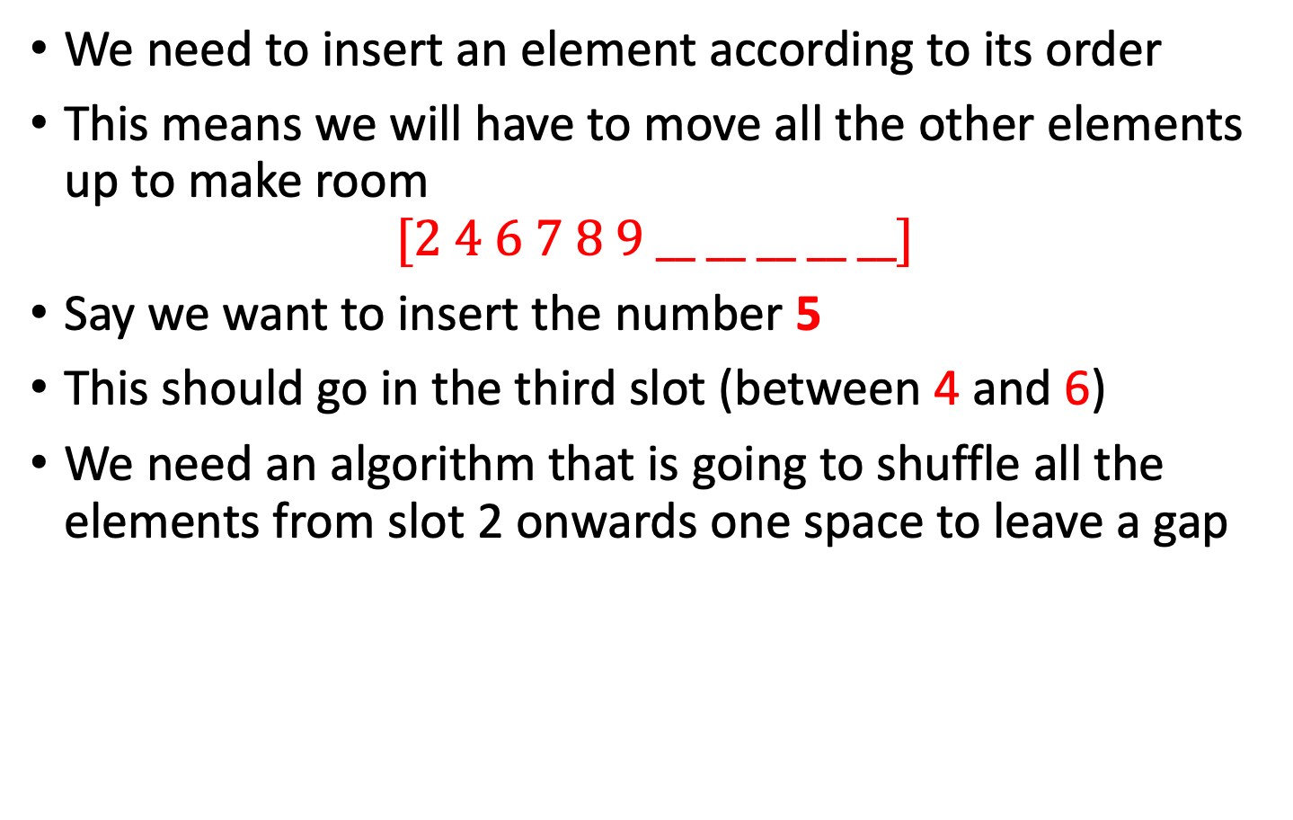
Inserting an element
We need to insert an element according to its order
This means we will have to move all the other elements up to make room
$$[2 4 6 7 8 9 __ __ __ __ __]$$
Say we want to insert the number 5
This should go in the third slot (between 4 and 6)
We need an algorithm that is going to shuffle all the elements from slot 2 onwards one space to leave a gap

Slide 79
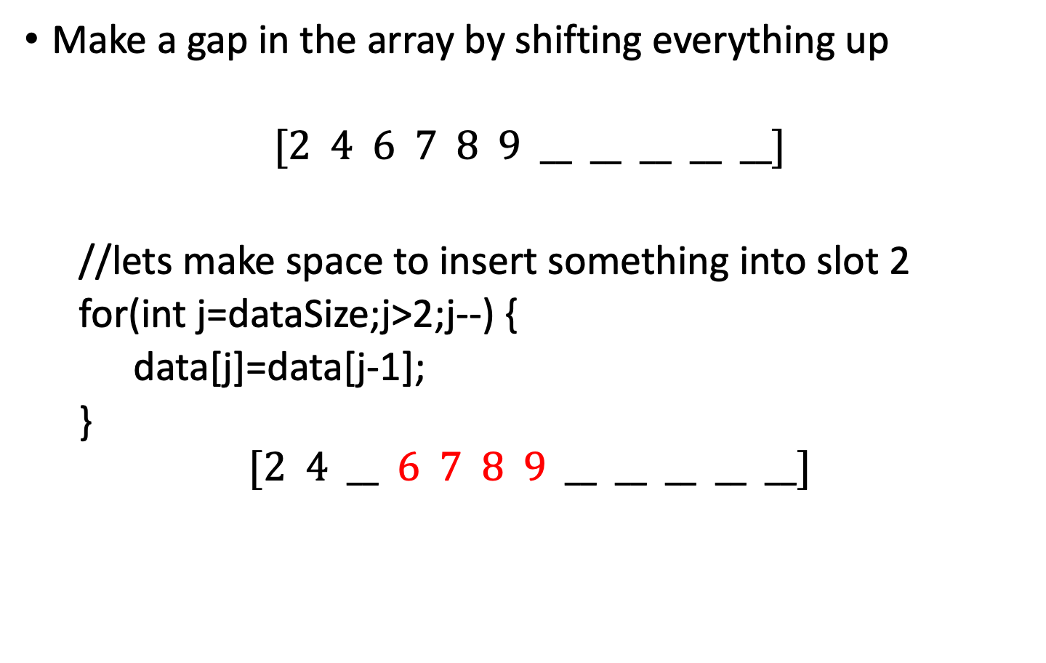
Inserting an element
Make a gap in the array by shifting everything up
$$[2 4 6 7 8 9 __ __ __ __ __]$$
//lets make space to insert something into slot 2
for(int j=dataSize;j>2;j--) {
data[j]=data[j-1];
}
$$[2 4 __ 6 7 8 9 __ __ __ __ __]$$

Slide 80
Full insertion method
public void insert(int value) {
int j = 0;
while(array[j] < value && j < nElems) { //find where it goes
j++; //linear search
}
for(int k = nElems; k > j; k--) { // move bigger ones up
a[k] = a[k-1];
}
a[j] = value; // insert it
nElems++; // increment size
} // end insert()

Slide 81
Removing an Element
Say we want to remove a particular element in our array
Once we delete it there will be a gap left in our array
If we don’t keep track of these gaps, then the array will just fill up with holes like a Swiss cheese
We need an algorithm that will move all the elements down to fill the gap that is created after one is removed

Slide 82
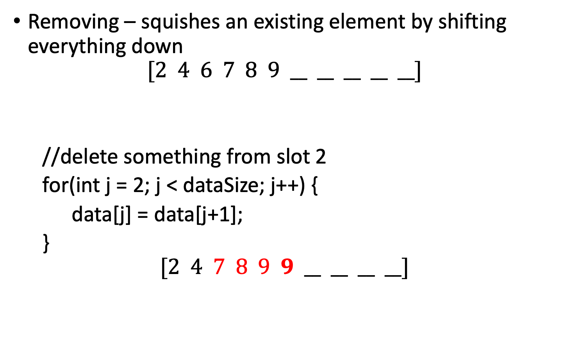
Removing an Element
Removing – squishes an existing element by shifting everything down
$$[2 4 6 7 8 9 __ __ __ __ __]$$
//delete something from slot 2
for(int j = 2; j < dataSize; j++) {
data[j] = data[j+1];
}
$$[2 4 7 8 9 9 __ __ __ __]$$

Slide 83
Evaluation of Ordered Arrays
Search process is much shorter (we can run a binary search)
Insertion takes longer because we have to move elements up to make room rather than just sticking a new element at the end
Deletion is slow for both ordered and unordered arrays since you have to move items down to get rid of gaps
Ordered arrays are useful in situations where searches are frequent and insertions are not
Good for a shelf of books in a library
Not useful for a book jumble sale

Slide 84
How good is binary search?
As arrays get bigger, using a binary search becomes more important
A linear search would take ages!
Size of Array | Comparisons Needed of Binary Search (Worse Case) | Comparisons Needed of Linear Search (Worse Case)
10 | 4 | 10
100 | 7 | 100
1,000 | 10 | 1,000
10,000 | 14 | 10,000
100,000 | 17 | 100,000
1,000,000 | 20 | 1,000,000
10,000,000 | 24 | 10,000,000
100,000,000 | 27 | 100,000,000
1,000,000,000 | 30 | 1,000,000,000

Slide 85
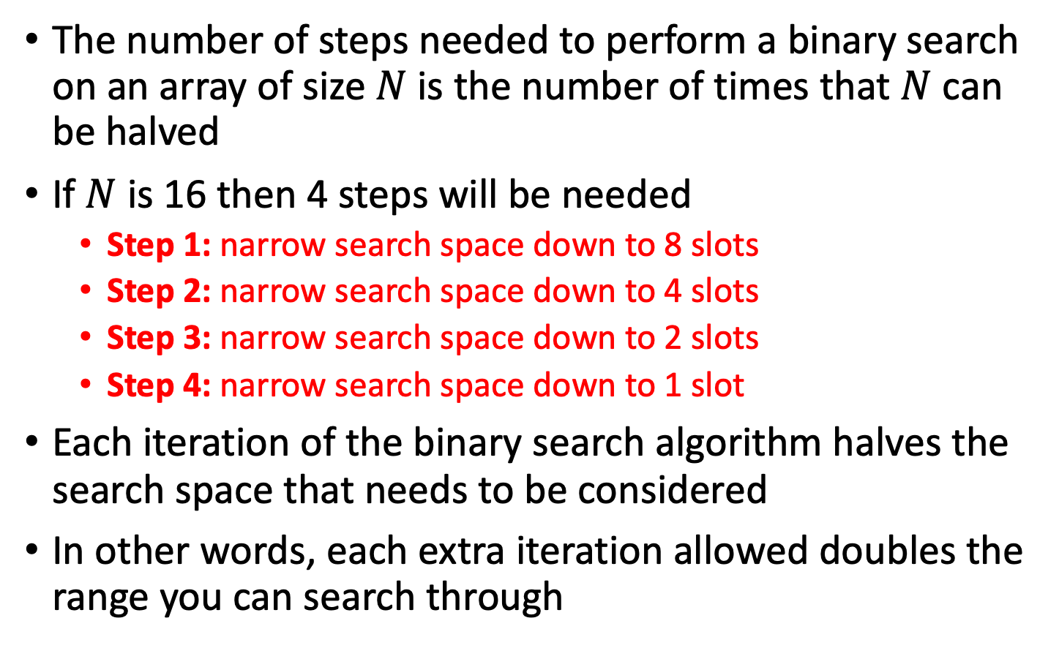
Mathematically
The number of steps needed to perform a binary search on an array of size $N$ is the number of times that $N$ can be halved
If $N$ is 16 then 4 steps will be needed
Step 1: narrow search space down to 8 slots
Step 2: narrow search space down to 4 slots
Step 3: narrow search space down to 2 slots
Step 4: narrow search space down to 1 slot
Each iteration of the binary search algorithm halves the search space that needs to be considered
In other words, each extra iteration allowed doubles the range you can search through

Slide 86
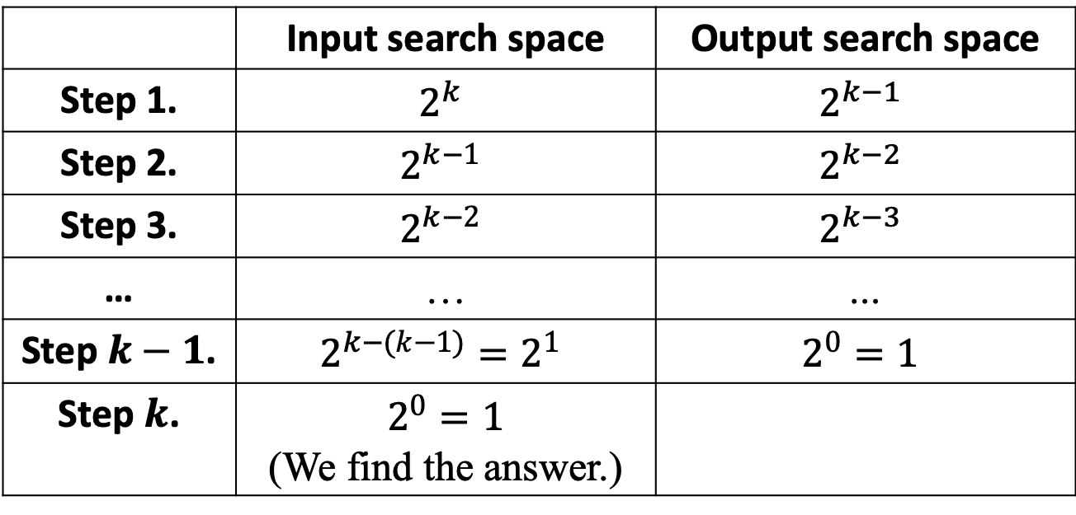
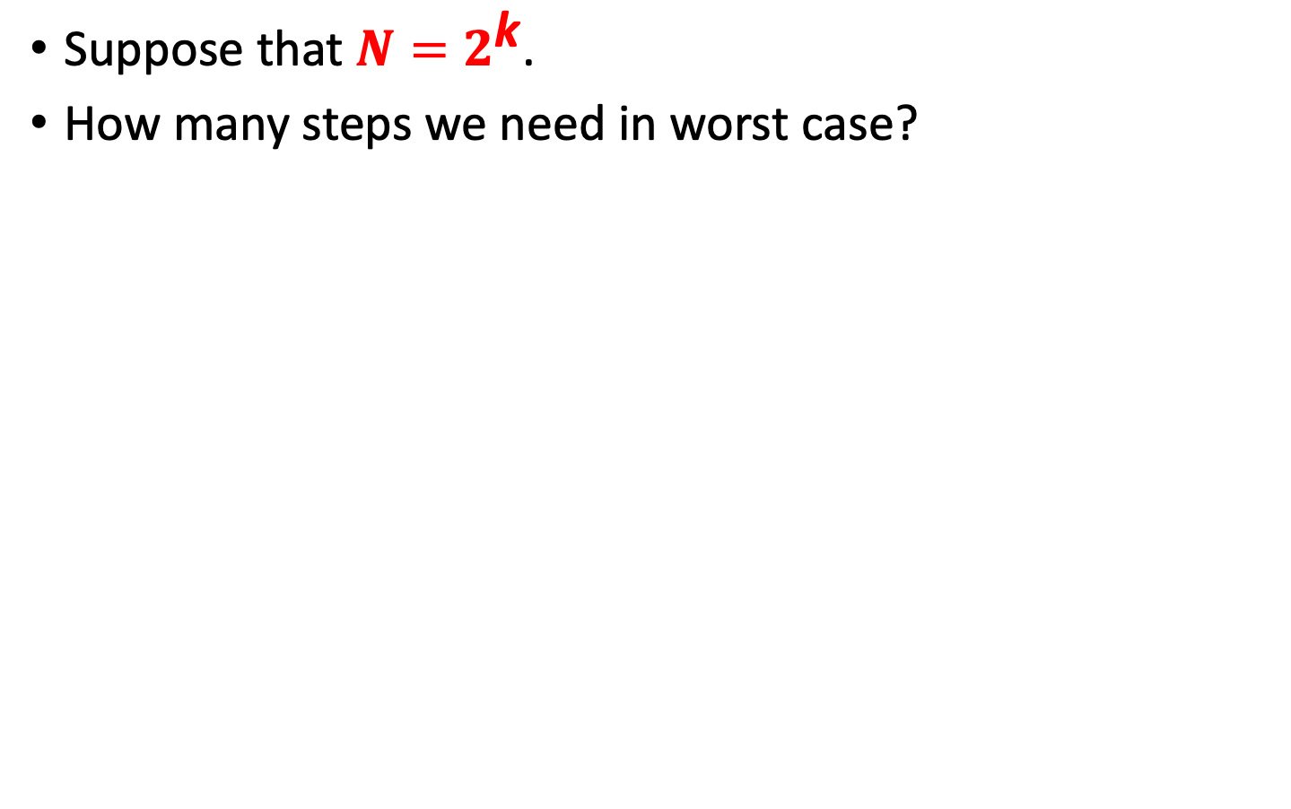
Mathematically
Suppose that $N=2^{\text{k}}$.
How many steps we need in worst case?
 | Input search space | Output search space
Step 1. | $$2^{k}$$ | $$2^{k−1}$$
Step 2. | $$2^{k−1}$$ | $$2^{k−2}$$
Step 3. | $$2^{k−2}$$ | $$2^{k−3}$$
… | … | …
Step $k−1$. | $$2^{k−(k−1)}=2^{1}$$ | $$2^{0}=1$$
Step $k$. | $$2^{0}=1$$ (We find the answer.)

Slide 87


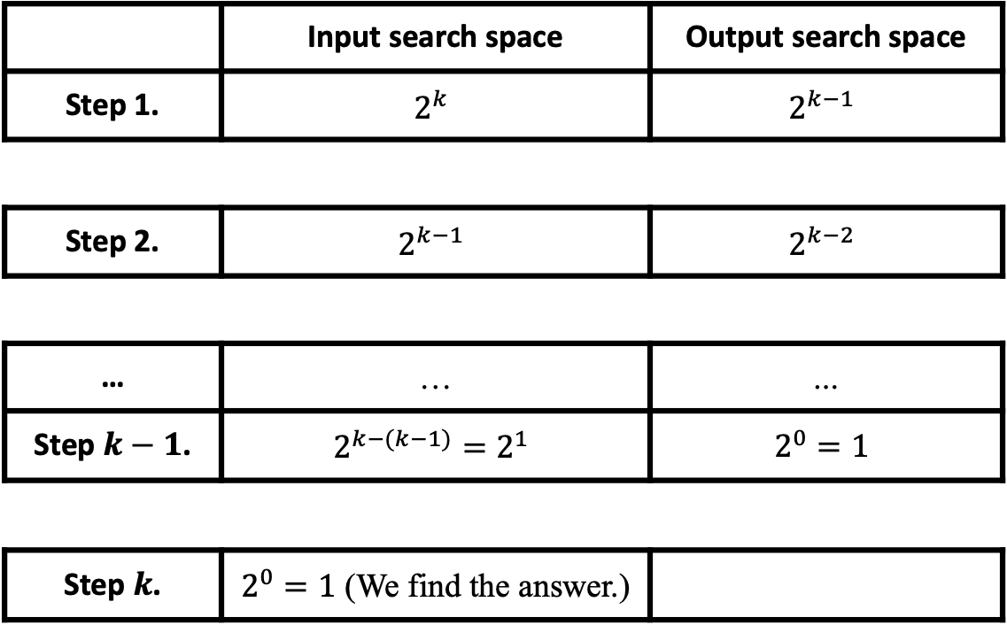



Analysis
How many steps we need in worst case?
//Suppose that that myArray[check] > searchKey
 | Input search space | Output search space
Step 1. | $$2^{k}$$ | $$2^{k−1}$$
Step 2. | $$2^{k−1}$$ | $$2^{k−2}$$
… | … | …
Step $k−1$. | $$2^{k−(k−1)}=2^{1}$$ | $$2^{0}=1$$
Step $k$. | $2^{0}=1$ (We find the answer.)
search space
$$0$$
$$2^{k}−1$$
search space
$$0$$
$$2^{k−1}−1$$
search space
$$0$$
$$1$$
search space
$$0$$

Slide 88
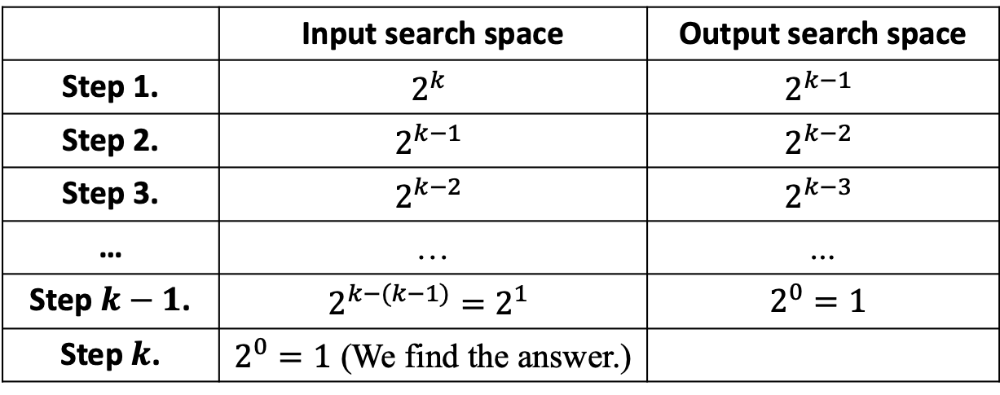
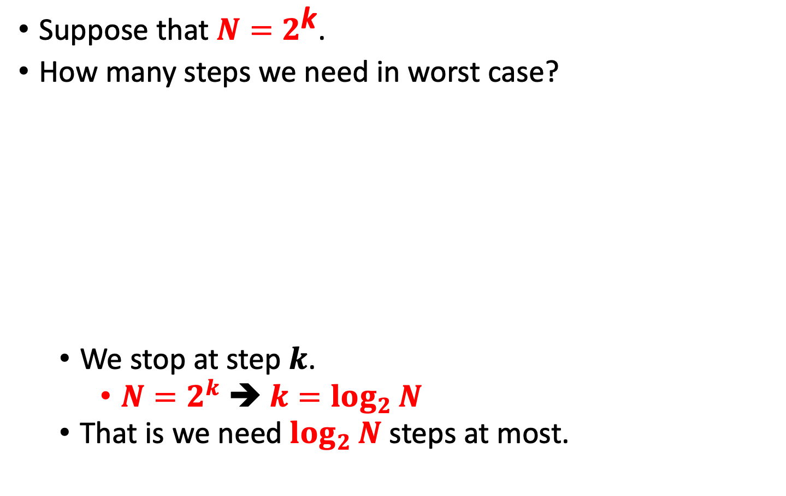
Analysis
Suppose that $N=2^{\text{k}}$.
How many steps we need in worst case?
We stop at step $k$.
$N=2^{k}$ ➔ $k=\log_{2}{N}$
That is we need $\log_{2}{N}$ steps at most.
 | Input search space | Output search space
Step 1. | $$2^{k}$$ | $$2^{k−1}$$
Step 2. | $$2^{k−1}$$ | $$2^{k−2}$$
Step 3. | $$2^{k−2}$$ | $$2^{k−3}$$
… | … | …
Step $k−1$. | $$2^{k−(k−1)}=2^{1}$$ | $$2^{0}=1$$
Step $k$. | $2^{0}=1$ (We find the answer.)

Slide 89
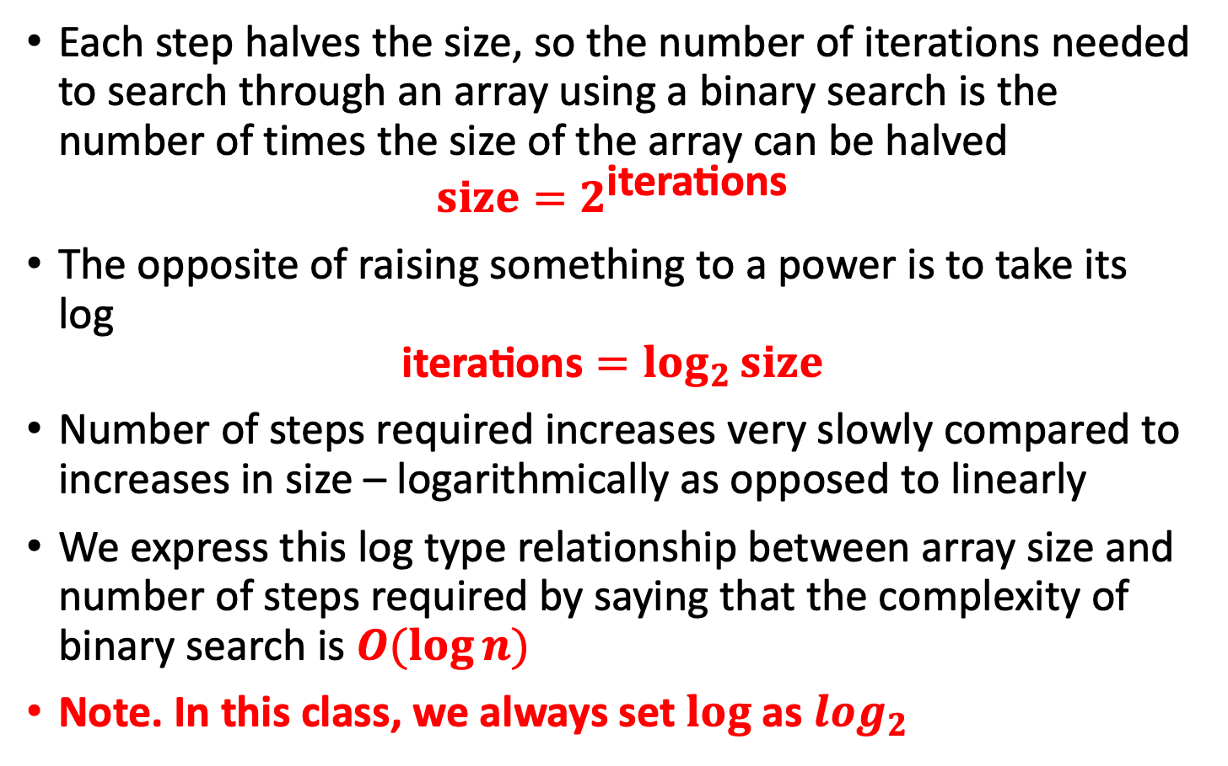
A log relationship
Each step halves the size, so the number of iterations needed to search through an array using a binary search is the number of times the size of the array can be halved
$$size=2^{\text{iterations}}$$
The opposite of raising something to a power is to take its log
$$\text{iterations}=\log_{2}{size}$$
Number of steps required increases very slowly compared to increases in size – logarithmically as opposed to linearly
We express this log type relationship between array size and number of steps required by saying that the complexity of binary search is $O(\log{n})$
Note. In this class, we always set $log$ as $\log_{2}$

